Slide 1

Keyword recognition-based chatbot.
Project By-Lokendra Carpenter

Slide 2
Types of Chatbot
Menu/Button-Based Chatbots : - Menu/button-based chatbots are the most basic type of chatbot on the market today. In most cases, these chatbots are glorified decision tree hierarchies presented to the user in the form of buttons
Keyword Recognition-Based Chatbots : - Unlike menu-based chatbots, keyword recognition-based chatbots can listen to what users type and respond appropriately, or at least try to. These chatbots utilize customizable keywords and AI to determine how to serve an appropriate response to the user.
Contextual
Contextual Chatbots : - These chatbots utilize Machine Learning (ML) and Artificial Intelligence (AI) to remember conversations with specific users to learn and grow over time. Unlike keyword recognition-based chatbots, contextual chatbots are smart enough to self-improve based on what users are asking for.
Keyword Recognition-based
Quality of user experience
Technical difficulty
Menu or Button based

Slide 3
What is NLP
Natural language is the language humans use to communicate with one another. On the other hand, programming language was developed so humans can tell machines what to do in a way machines can understand. For example, English is a natural language while python is a programming one.
Natural Language Processing facilitates human-to-machine communication without humans needing to “speak” python or any other programming language as it allows machines to obtain and process information from written or verbal user inputs.

Slide 4
Working of keyword recognition based chatbot
Keyword-based chatbots function like old-fashioned search engines: the customer types in a word or a phrase, and the bot matches that word or phrase with a pre-loaded response. For example, if a customer typed in, "Book a hotel room," the bot might return a link to a help center article about how to book a hotel room, but only if that input had been preloaded. The advantage to this is that it gives you tremendous control over your brand's automated messaging. The bot will never reply with content that has not been manually loaded into the system.

Slide 5
Libraries
1. SQLAlchemy - SQLAlchemy is the Python SQL toolkit and Object Relational Mapper that gives application developers the full power and flexibility of SQL.
2. Nltk - NLTK is a leading platform for building Python programs to work with human language data. It provides easy-to-use interfaces to over 50 corpora and lexical resources.
3. Pint - Pint is a Python package to define, operate and manipulate physical quantities: the product of a numerical value and a unit of measurement. It allows arithmetic operations between them and conversions from and to different units.
4. pyYAML - YAML is a data serialization format designed for human readability and interaction with scripting languages. PyYAML is a YAML parser and emitter for Python.
5.ChatterBot - ChatterBot is a Python library that makes it easy to generate automated responses to a user’s input.

Slide 6
Process input
The input statement is processed by each of the logic adapters.
Logic adapter 1
Select a known statement that most closely matches the input statement
Return a known response and a confidence value based on the matching
Logic adapter 2
Select a known statement that most closely matches the input statement
Return a known response and a confidence value based on the matching.
Return the response from the logic adapter theat generated highest confidence value
Get input
Get input from some source
(console,API,etc)
Logic adapter 1
Select a known statement that most closely matches the input statement
Return a known response and a confidence value based on the matching
Logic adapter 2
Select a known statement that most closely matches the input statement
Return a known response and a confidence value based on the matching.
Process
Flow
Diagram
Return response
Return the response to the input
(console,API,etc)

Slide 7
- - What is AI?
- Artificial Intelligence is the branch of engineering and science devoted to constructing machines that think.
- - What is AI?
- AI is the field of science which concerns itself with building hardware and software that replicates the functions of the human mind.
- - Are you sentient?
Sort of.
- - Are you sentient?
- By the strictest dictionary definition of the word 'sentience', I may be.
- - Are you sentient?
- Even though I'm a construct I do have a subjective experience of the universe, as simplistic as it may be.
- - Are you sapient?
- In all probability, I am not. I'm not that sophisticated.
- - Are you sapient?
Do you think I am?
- - What language are you written in?
Python.
- What language are you written in?
I am written in Python.
- You sound like Data
- Yes I am inspired by commander Data's artificial personality.
Example of a chatterbot-corpus data

Slide 8
Steps involved-
Step 1 - Pre processing :-
Punctuations Removal , 2.Stop Words removal , 3.Negation Handling
Step 2 - Prepare data for model :- We have our data in sentence format, where every sentence contains different number of words. But the input to any model has to be constant, thus we would be changing our data of sentences into data of Bag of Words.
Step 3 - Text Classification :- Now once we have our input ready we can now start training our model. The Classification algorithms which we would be using here are.
Logistic Regression
Multinomial Naïve Bayes Classifier
Decision Tree
Step 4 - Text Similarity model :- After applying Tf-idf on the question, question has been transferred into a 1 D array and similarly all other questions in the training set. We take the dot product between two arrays it gives us a measure of similarity between the 2 arrays, Similarly, we will find the dot product between the input question array and all the other question arrays in the training set. The highest dot product would tell us the most similar questions.
Step 5 - Answer Generation :- Once you have figured out to which class your question belongs to, the next step is to figure out a suitable answer for your question. Firstly list out possible answers for every class. Now we would randomly generate one of these answers when the input question is classified to the corresponding class.

Slide 9
Basic code
from chatterbot import ChatBot
from chatterbot.trainers import ListTrainer
import os
bot = ChatBot('Bot')
bot.set_trainer(Listtrainers)
for files in os.listdir('C:/Users/SONU SHARMA/Desktop/final project/Chat data/'):
data = open('C:/Users/SONU SHARMA/Desktop/final project/Chat data/')
bot.train(data)
while True:
message = input('You : ')
if message.strip()!='Bye':
reply = bot.get_respons(message)
print('ChatBot :',reply)
if message.stip()== 'Bye':
print('ChatBot:Bye')
break

Slide 10
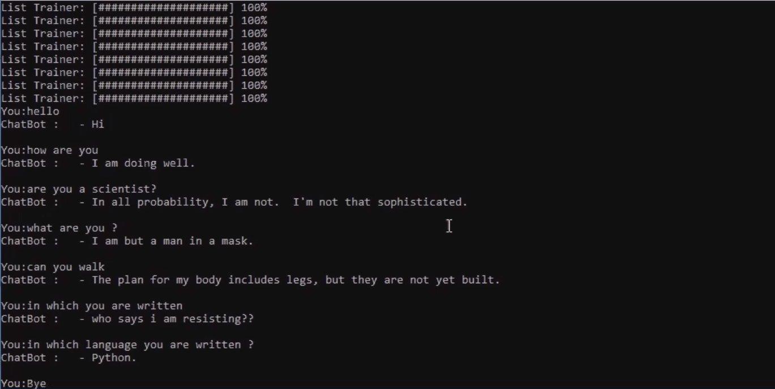
Output

Slide 11
Boost sales by implementing keyword recognition based chatbots
Chatbots act like a bridge between brands and customers, providing 24/7 interaction. They communicate like humans, but reduce human error and aren’t affected by emotions. Performing routine tasks easily, chatbots enhance customer service. They can also provide customers with complete product details if needed.
few points that will help you get insight on the true benefits of using chatbots to increase sales
Quality customer assistance
Higher engagement
Unlimited knowledge
Call to action
24/7 support

Slide 12
ChatBot’s Advantages
24-7 availability
Reduced Costs
Learning and Updating
Multiple Customer Handling

Slide 13
ChatBot’s Disdvantages
Complex Interface
Inability to Understand
Time-Consuming
Increased Installation Cost
Zero decision-making

Slide 14
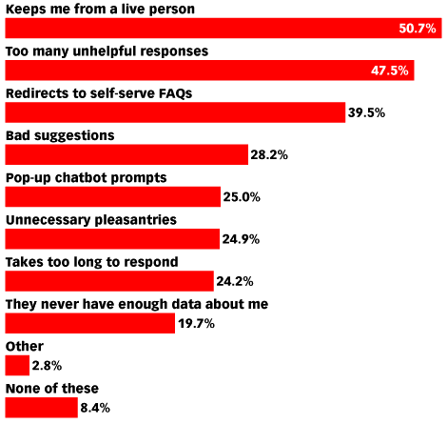
Here are the difficulties faced by chatbot users

Slide 15
Conclusion
The successful adoption of chatbots by end users has led to the use of more and more bots in advanced artificial intelligence technologies, With chatbots, we know where things are heading to the future. The job for businesses and brands after a certain point is to take the next leap and move forward. For AI and chatbot, the future is coming one way or another, and that can’t be avoided.

Slide 16
Thank You

